Slide 1
Introduction to InterneT
Computer Science Department
Faculty of Computer and Mathematical Sciences

Slide 2
TOPICS
Introduction to the Internet and the World Wide Web
HTML
Client-side scripting – using Javascript
Server-side scripting – using Active Server Pages and Javascript
Current technologies

Slide 3





CHAPTER 1
THE INTERNET & THE WORLD WIDE WEB

Slide 4
Brief History of the Internet
1940’s
Big computers. Contain vacuum tube.
1960’s
Computer size has shrunk.
Computer network is maintained by the Universities.
Computer network is used by Department of Defense (DoD).

Slide 5
1969
Department of Defense created first functioning Internet.
  Only has four networked computers connecting UCLA, UC Santa Barbara, University of Utah and Stanford Research Institute.
  Called ARPANET (Advanced Research Projects Agency Network)
  The purpose of the creation was to maintain communication in the event of nuclear war.

Slide 6
1970s
ARPANET gradually expanded. By 1984 it reached 1000 hosts.
1980s
NSFNET (National Science Foundation) was created in 1986.
Connect computers and engineering research.
Expanded rapidly, by 1990 it has 100,000 hosts.

Slide 7
1990
NSFNET replaced ARPANET as Internet Backbone (the main network line)
1992
World Wide Web (WWW) appeared. It was created by Tim Berners-Lee

Slide 8
Internet
The Internet is a global interconnected computer networks that use the standardized Internet Protocol Suite (TCP/IP). It is a network of networks that consists of millions of private and public, academic, business, and government networks of local to global scope that are linked by copper wires, fiber-optic cables, wireless connections, and other technologies.

Slide 9
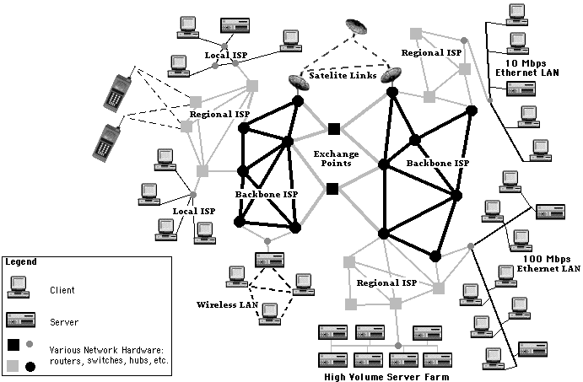
The Inter-network is a big network of networks.

Slide 10
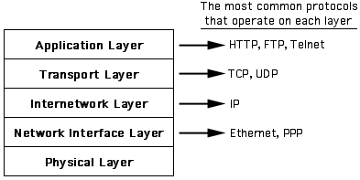
The five-layer networking model for the internet.

Slide 11
TCP/IP (Transmission Control Protocol/Internet Protocol)
protocol that is used to enable communication on the Internet.
coordinate the addresses of all the computers on the Internet and the away resources are passed around

Slide 12
Internet
Internet is mainly built on client and server technology. In this concept, we have a number of computers that houses information that users can access via their computers. The computers that house the information is known as server while the user’s pc that access the server’s information is known as client.

Slide 13
Internet
The Internet carries a vast array of information resources and services, most notably, the inter-linked hypertext documents of the World Wide Web (WWW) and the infrastructure to support electronic mail, in addition to popular services such as online chat, file transfer and file sharing, online gaming, and Voice over Internet Protocol (VoIP) person-to-person communication via voice and video.

Slide 14
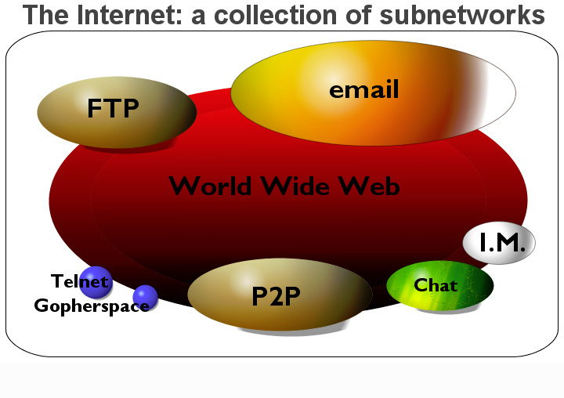
Internet Vs WWW
(SMTP)
(HTTP)
Notes:
The Internet is the container of the WWW. The Internet consists of many services, such as the WWW, email (SMTP), FTP, Instant messages and usenet user groups. The Internet supports many languages, however the WWW only supports HTTP.

Slide 15
The World Wide Web
The World Wide Web (commonly abbreviated as the "Web") is a system of interlinked hypertext documents accessed via the Internet. With a Web browser, one can view Web pages that may contain text, images, videos, and other multimedia and navigate between them using hyperlinks

Slide 16
Too many to juggle now?
Do you still want to continue?
Look what will happen to you if you don’t do well in this course or any other courses
Lessons learned

Slide 17
Example of www protocol
how://where/what
protocol address resource
Eg:
http://www.perlis.uitm.edu.my/e-learn
http://www.perlis.uitm.edu.my/jsk//index.php

Slide 18
Intranet
A private network that is connected via Internet technology (TCP/IP connection and support Web browsing). It is accessible only to those in the organization. Eg: large companies and universities.
Only those in the organization will be authorized to access the resources located in the Intranet setup.
Eg: Intranet application such as staff portal, online databases

Slide 19
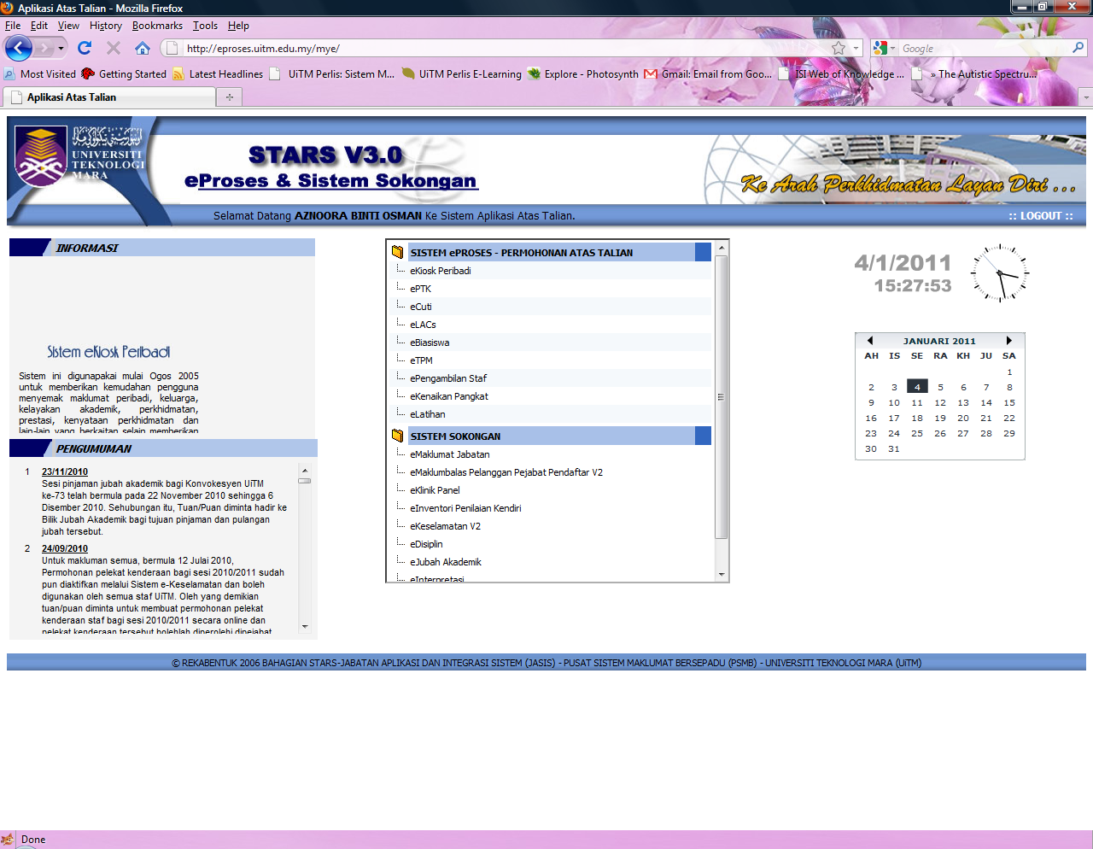

Slide 20
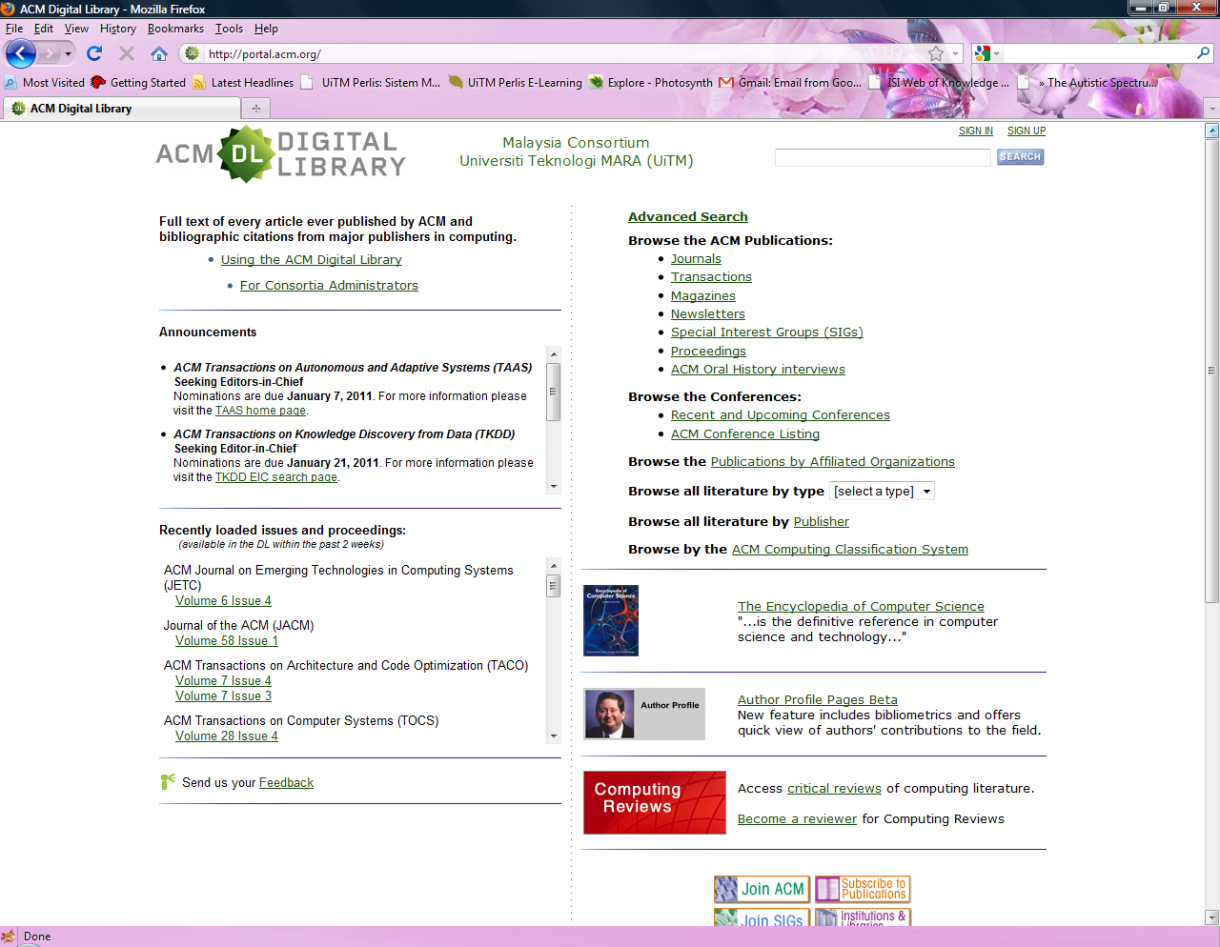

Slide 21
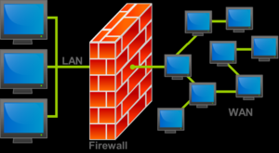
Intranet
Firewalls are frequently used to prevent unauthorized Internet users from accessing private networks connected to the Internet, especially intranets

Slide 22
Internet Protocol (IP) Addresses
Each computer on the Internet has to have an address.
The address is known as IP address.
Standard IP address follow the following format:
_______. _______. _______. _______
Example: 192.24.21.11

Slide 23
Routers and Packets
Information from one computer will be divided into small parts less than 1.5 kilobyte. It is passed from one IP address to another. This small segment is known as packet.
The packets will be transmitted through the Internet infrastructures (modem, routers, etc.) and recombined when it reached destination.
The TCP connection between two computers is called socket.

Slide 24
Named Addresses and Domains
Named address is the name that we use when accessing a host/server. An example of named address is www.uitm.edu.my. Named address is also known as Domain name.
Named address has a corresponding number that is assigned to the server. This number is known as Internet Protocol (IP) address. An example of IP address is 10.0.28.2. IP address for www.uitm.edu.my is 202.58.80.221, while for www.perlis.uitm.edu.my, the IP add. is 210.48.147.7.
In other words, a host/server usually will have IP address and named address. User can type either one of these addresses when they want to access any resources that reside on the host. However, ordinary user usually prefers to use Domain name as it is easier to remember.

Slide 25
Domain Suffixes
Domain Suffixes is an extension to domain name to represent special meaning such as the type of organization and country of origin.
For example .org refers to a website/host that belongs to non profit organization. gov refers to a website/host that belongs to government institutions etc.

